Slide 1

GEETHANJALI COLLEGE OF ENGINEERNING AND TECHNOLOGY CHEERYAL(V),KEESARA(M),MEDCHAL DIST(T.S).
COVID VACCINATION CLASSIFICATION USING PROTÉGÉ TOOL AND
COVID-19 APPLICATION
INTERNAL GUIDE
C. ESTHER VARMA MTECH(SE).
ASSOCIATE PROFESSOR,
CSE DEPARTMENT
TEAM
Nikhila Polkampally 18R11A05C6
Kakarla Satya Srilatha 18R11A05A9
Mettu Karuna Sri Reddy 18R11A05C2
P. Bhumika Priya 18R11A05C7

Slide 2
Abstract
The project is to classify the data using supervised learning approach in machine learning, which has been preprocessed . After the classification is done, with the help of opinion mining with decision making and the classified data is stored in the database, with the use of semantic web ontology using protégé tool. The data will be retrieved through SPARQL which helps to retrieve complex queries, followed by the output based on the given query.
We added the desktop application where the user enter the details for registration like name, username, password, re-enter password, gender, email and mobile number and use the same credentials for login purpose. If the user logged in successfully then the new window appears where the user gives the covid-19 details and according to the given details we analyze the risk factors and recommend the treatment plans for the user.

Slide 3
LITERATURE SURVEY
Baker, M. (2012). Databases ﬁght funding cuts: on-line tools are becoming ever more important to biology, but ﬁnancial support is unstable. Nature, 489(7414):19.
Bechhofer, S., Horrocks, I., Goble, C., and Stevens, R. (2001). OilEd: a reason-able ontology editor for the Semantic Web. In: Proceedings of the Joint German/Austrian Conference on Artiﬁcial Intelli-gence, Vienna.
World Health Organization (WHO), "Coronavirus disease 2019 (COVID-19) Situation Report - 35," WHO, 2020.
Crubézy, M. and Musen, M.A. (2004). Ontologies in support of problem solving. In: Staab, S. and Studer, R. eds. Handbook on Ontologies. Berlin: Springer-Verlag, pp. 321–341.
Eriksson, H., Puerta, A.R., and Musen, M.A. (1994). Generation of knowledge-acquisition tools from domain ontologies. International Journal of Hu-man–Computer Studies, 41:425–453.

Slide 4
EXISTING SYSTEM
The COVID-19 dataset has only predicted the active, death, hospitalized and recovered ratios all over the world.

Slide 5
PROPOSED SYSTEM
In this project, we propose a Covid-19 ontology that helps in collecting, analyzing, and sharing medical information about people in this domain. In particular, the proposed ontology uses information about diagnosis, vaccination history, and symptoms in order to analyze Covid-19 risk factors of people and their treatment plans. In this way, information about Covid-19 students can be automatically processed and can be re-usable by other applications. We also demonstrate extensive semantic queries (i.e., SPARQL queries) to search the created metadata. Furthermore, we illustrate the usage of semantic rules (i.e., SWRL) so that treatment plans for individual patients can be inferred from the available knowledge.

Slide 6
PROPOSED SYSTEM CONTD..
We added the desktop application where the user enter the details for registration like name, username, password, re-enter password, gender, email and mobile number and use the same credentials for login purpose. If the user logged in successfully then the new window appears where the user gives the covid-19 details and according to the given details we analyze the risk factors and recommend the treatment plans for the user.

Slide 7
SOFTWARE REQUIREMENT
Os: any graphical os
Languages: python, SPARQL
Editor: jupyter notebook
Tools: protégé tool

Slide 8
HARDWARE REQUIREMENT
Processor: Core 2 Duo or Higher
RAM: 1 GB
Hard disk: 10 GB

Slide 9
SYSTEM DESIGN

Slide 10
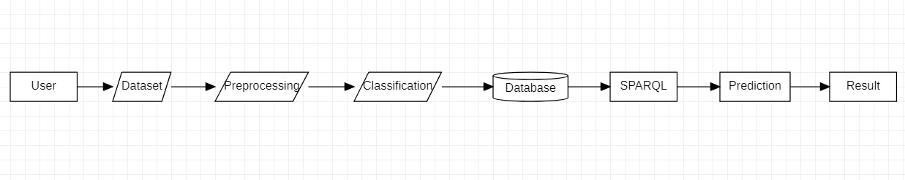
SYSTEM ARCHITECTURE

Slide 11
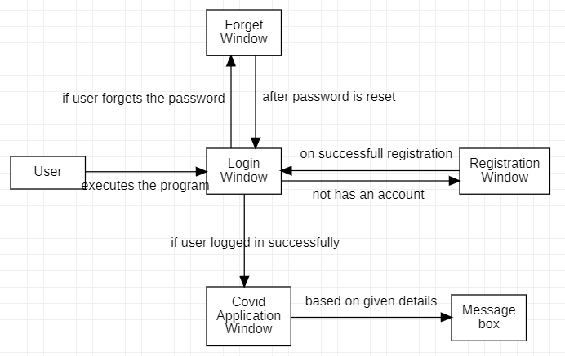

Slide 12
MODULES DESCRIPTION
Dataset Collection: We have collected the dataset from all 4th year students. Which are required to predict the data.
Prediction Module: Now we will give the dataset to the system we want to predict. Now the data will be processed and classification is done with the help of opinion mining with decision making and data is stored in the database with the use of semantic web ontology using protégé tool. In this project, the predictions on various cases have been done and finally, the accuracy of the algorithm has been determined. It provides data analysis of all 4th year vaccination details by querying.
Login Module: User enters a email and password. Login module application database is checked for a user matching the email and password. Valid user is found and users database is checked to see if the user exists. If user exists, user is logged in.

Slide 13
MODULES DESCRIPTION CONTD..
Registration Module: This page will ask user to enter name, username, password, re-enter password, gender, email-id, security question, answer, mobile no, and click on register button. If the user click on register button without entering any of the above details, then the pop- up window will display the warning message accordingly. If the user enters all the details correctly and click on register button then the pop-up window will display the message “User is successfully registered. You can login now”.
Application Module : The user have to enter the details like name, diagnosis(COVID-19_Positive or COVID-19_Negative), Symptoms(Common Symptoms or No Symptoms or Serious Symptoms), Vaccination History(Fully Vaccinated or Not Vaccinated or Started Vaccination) and click on submit button. If the user click on submit button without entering any of the above details, then the pop- up window will display the warning message accordingly. If the user enters all the details correctly and click on submit button then in the pop-up window, we will recommend the treatment plan and analyze the risk factor accordingly.

Slide 14
MODULES DESCRIPTION CONTD..
Forget Password Module: This page will ask user to enter security question, answer, new password, and click on reset password button. If the user click on reset password button without entering any of the above details, then the pop- up window will display the warning message accordingly. If the user enters all the details correctly and click on reset password button then the pop-up window will display the message “Password is changed successfully. You can login now”.

Slide 15
UML DIAGRAMS

Slide 16
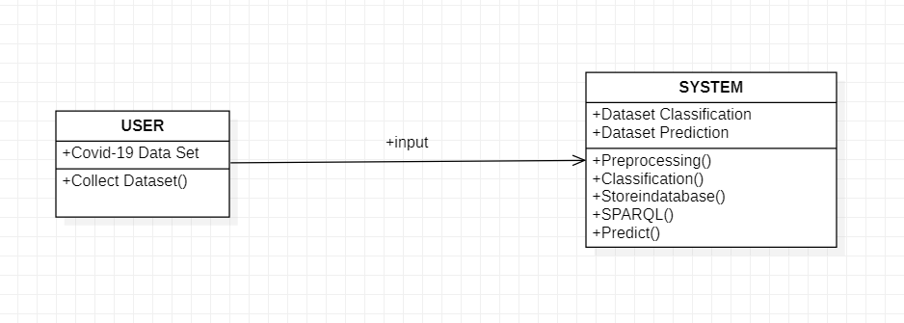
CLASS DIAGRAM

Slide 17
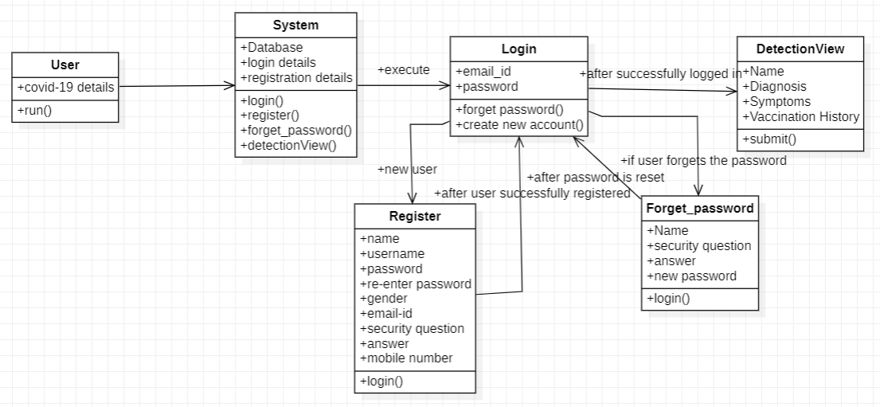

Slide 18
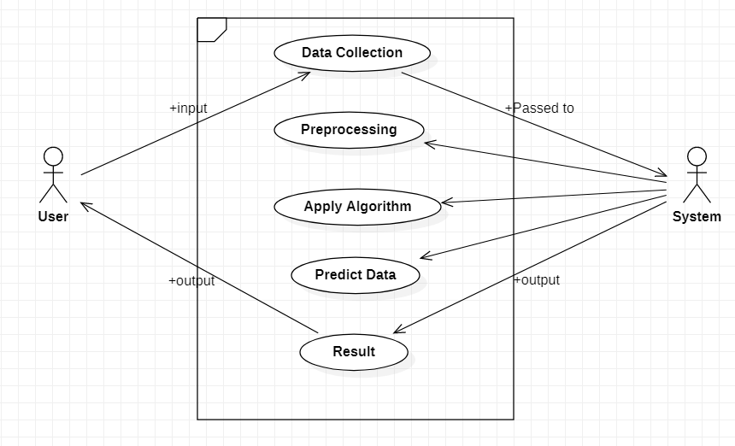
USE CASE DIAGRAM

Slide 19
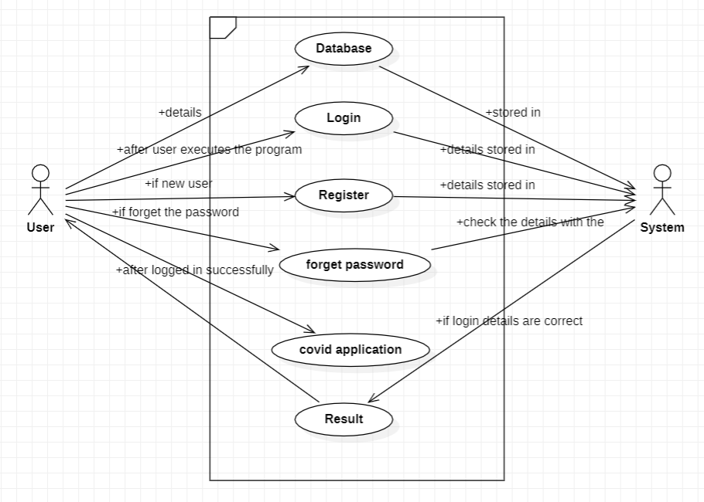

Slide 20
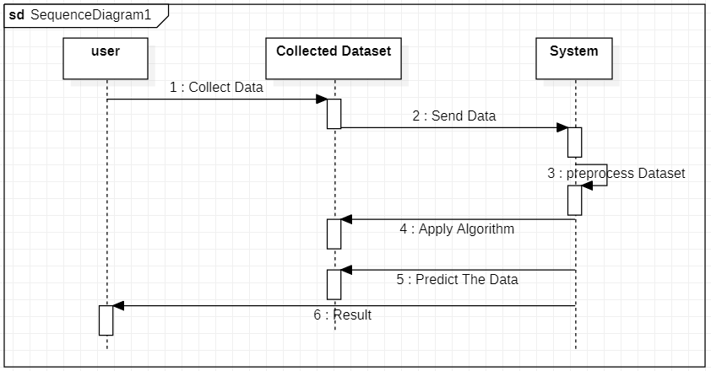
SEQUENCE DIAGRAM

Slide 21
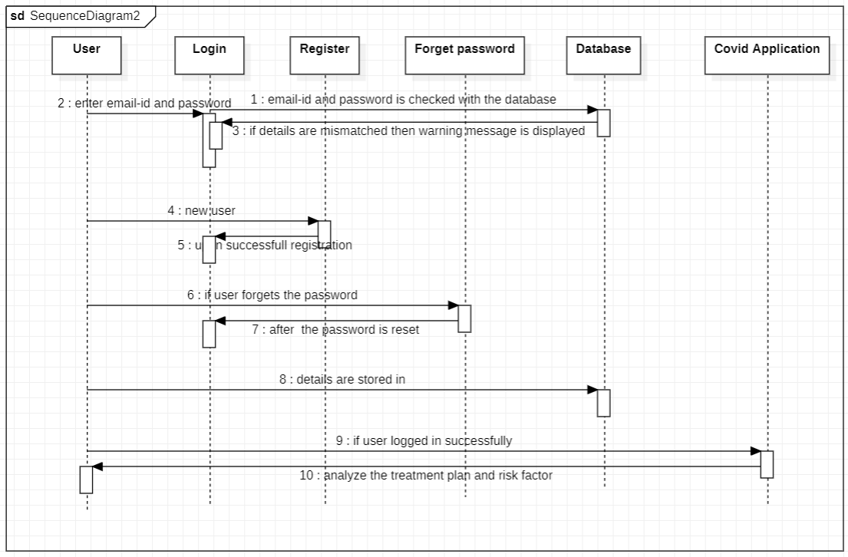

Slide 22
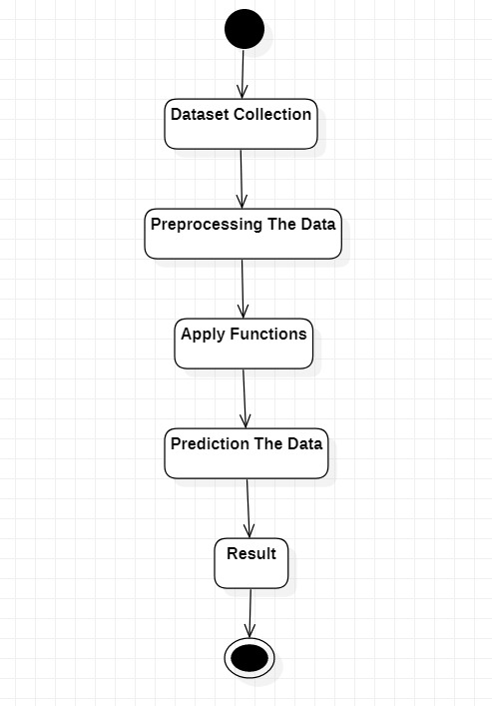
ACTIVITY DIAGRAM

Slide 23
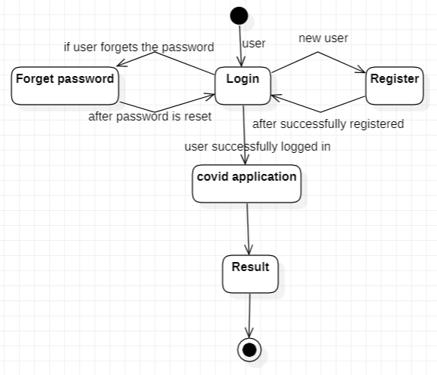

Slide 24
EXECUTION STEPS FOR DESKTOP APPLICATION
Step 1: Run the application with the following command:
> python app.py
Step 2: The user enters to the login page and enters a email-id and password. Login module application database is checked for a user matching the email-id and password. Valid user is found and users database is checked to see if the user exists. If user exists, user is logged in and covid-19 application form will be opened otherwise, the pop window will display the warning message(Invalid email-id or password).
Step 3: If the user is new to the application then the user need to register first by clicking “create new account” button in the login page .In registration window the user asked to enter name, username, password, re-enter password, gender, email, security question, answer, mobile number and if the user click on register button without entering any of the above details, then the pop- up window will display the warning message accordingly. If the user enters all the details correctly and click on register button then the pop-up window will display the message “User is successfully registered. You can login now”.

Slide 25
EXECUTION STEPS FOR DESKTOP APPLICATION CONTD..
Step 4: If the user forgets the password, then the user need to click on “forget password?” button and then the user enters to the forget password window where the user asked to enter the security question, answer, and new password and click on reset password button. If the user click on reset password button without entering any of the above details then, the pop- up window will display the warning message accordingly. If the user enters all the details correctly and click on reset password button then the pop-up window will display the message “Password is changed successfully. You can login now”.
Step 5: If the user enter all the details correctly in the login window then the covid-19 application window will appear. Here, the user enter the name, diagnosis, symptoms and vaccination history and click on submit button. If the user click on submit button without entering any of the above details, then the pop- up window will display the warning message accordingly. If the user enters all the details correctly and click on submit button then in the pop-up window, we will recommend the treatment plan and analyze the risk factor accordingly.

Slide 26
EXECUTION STEPS FOR PROTÉGÉ TOOL
Step 1: Open the protégé tool.
Step 2: Import the dataset.
Step 3: The data classification is done, with the help of opinion mining with decision making and the classified data is stored in the database, with the use of semantic web ontology using protégé tool.
Step 4: Now, go to the SPARQL tab and give the queries. Outputs will be displayed based on the given queries.

Slide 27
OUTPUT SCREENS

Slide 28
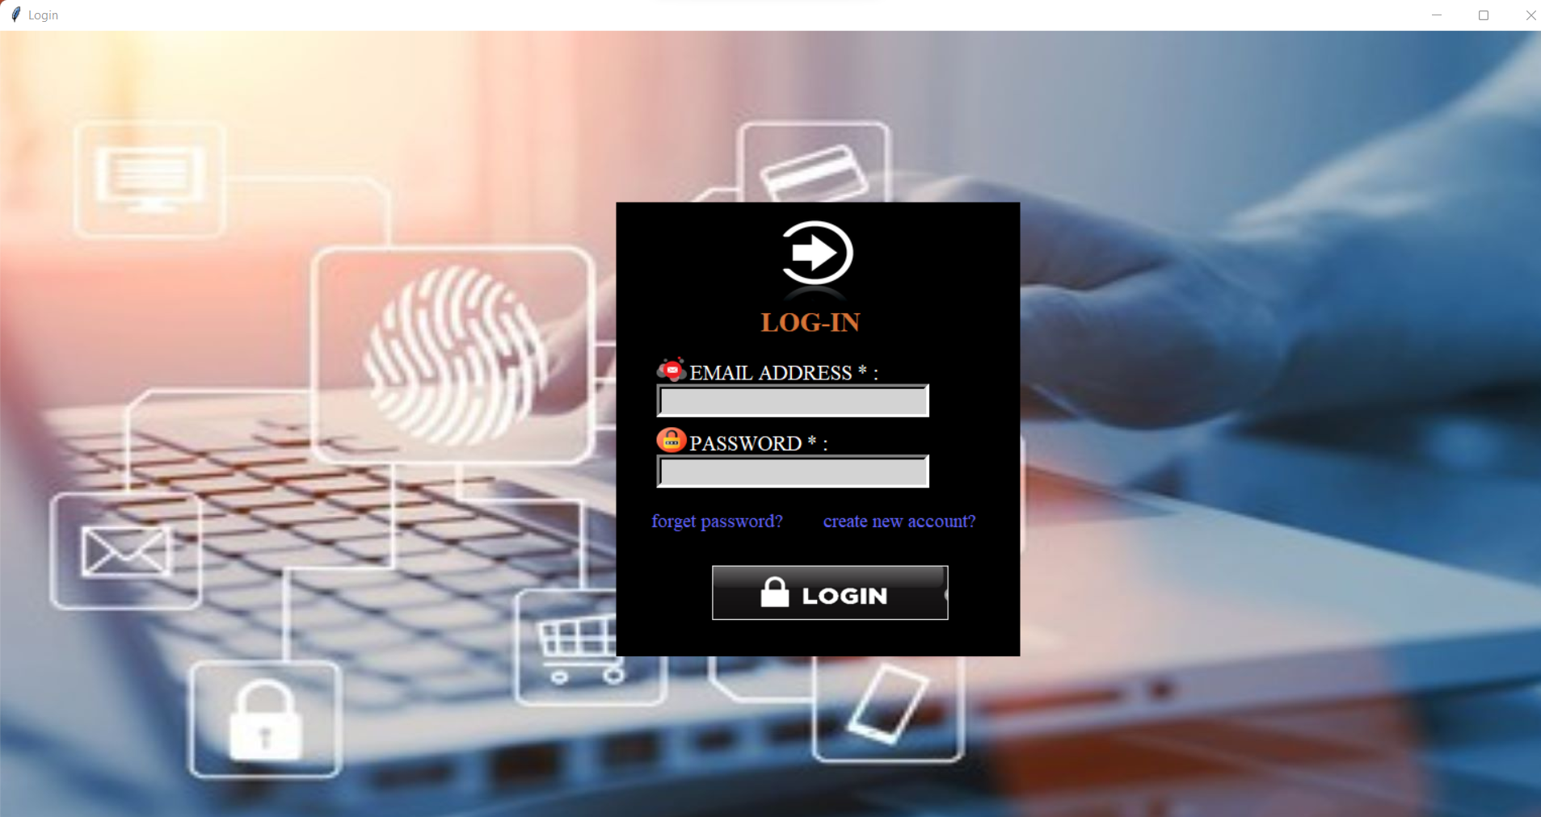
1.LOGIN WINDOW

Slide 29
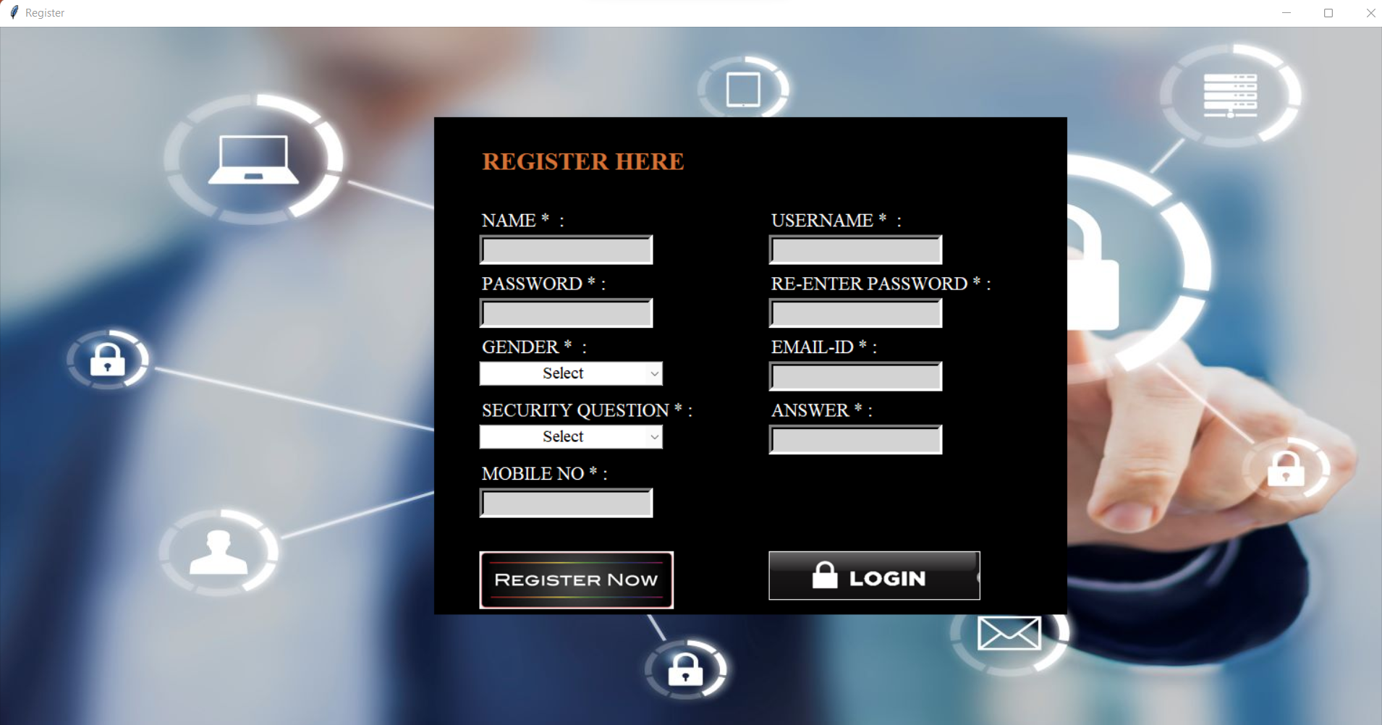
2.REGISTRATION WINDOW

Slide 30
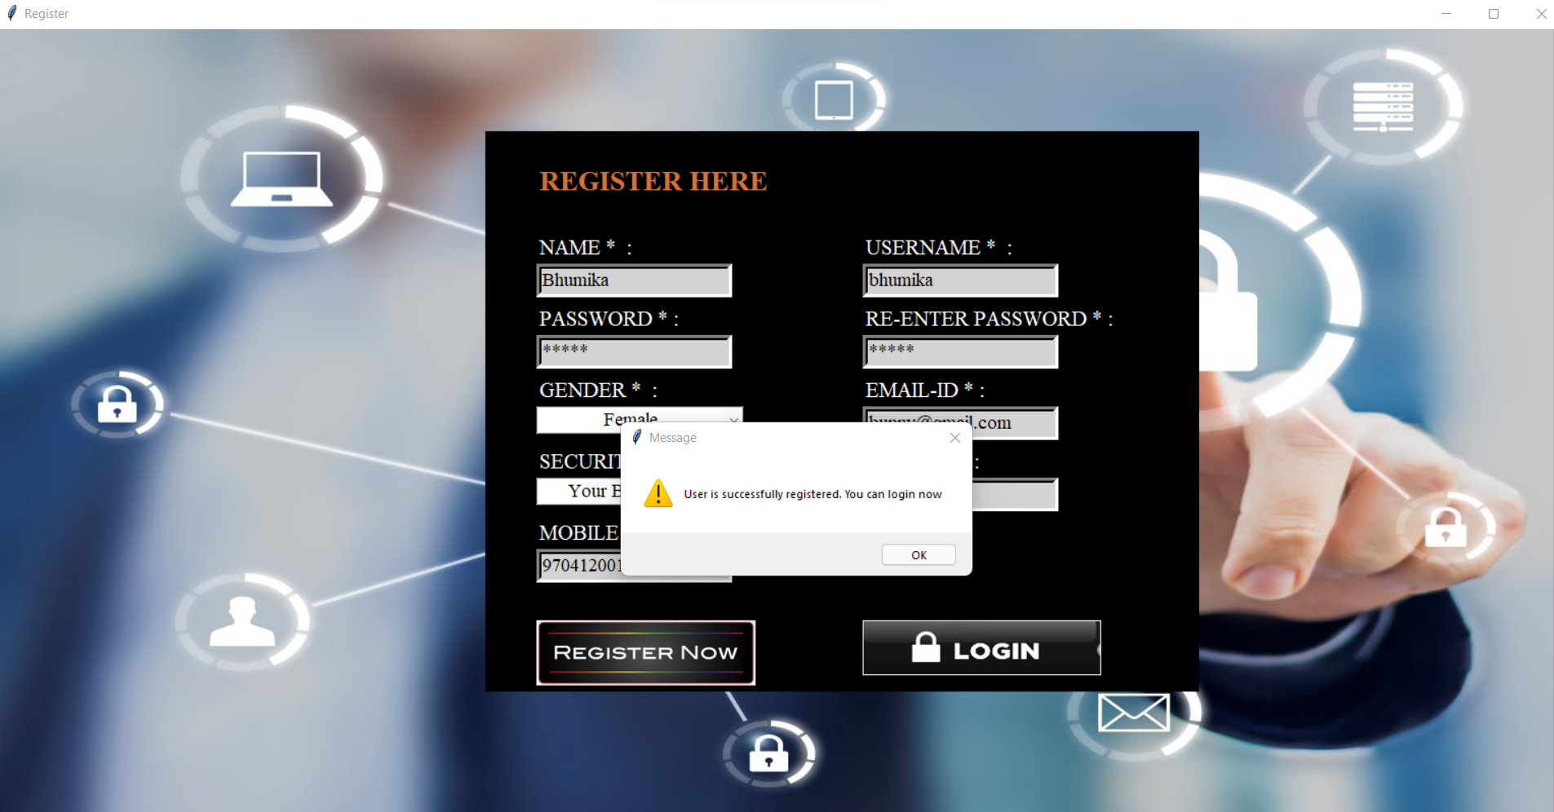

Slide 31
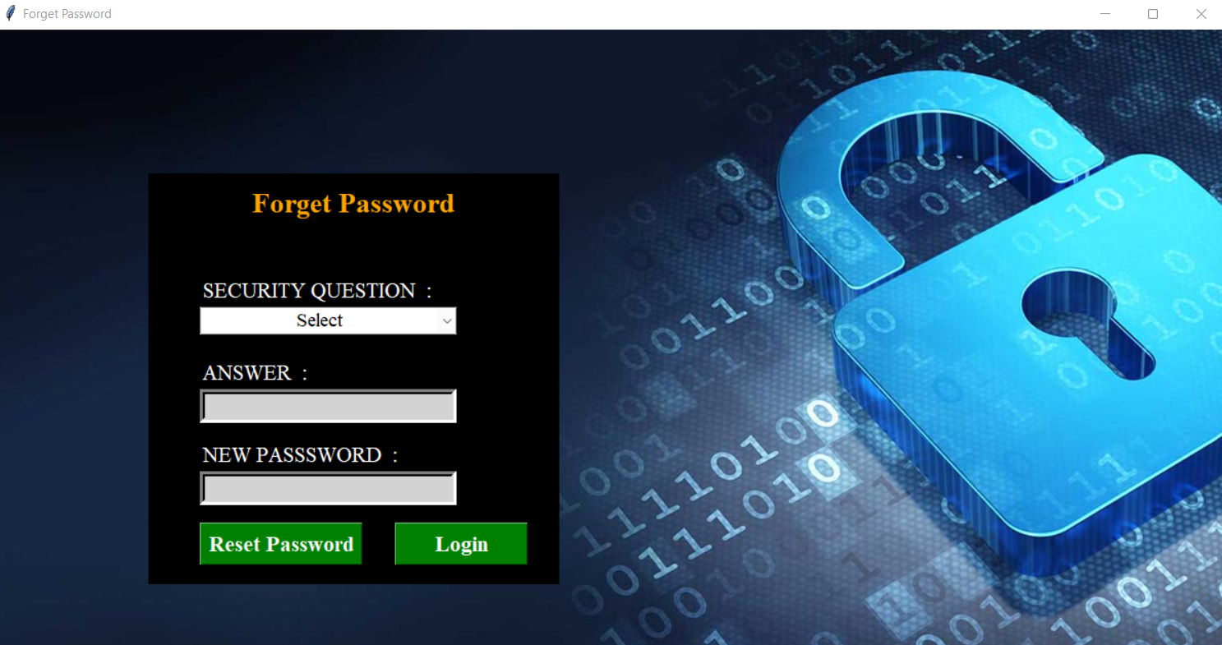
3.FORGET PASSWORD WINDOW

Slide 32
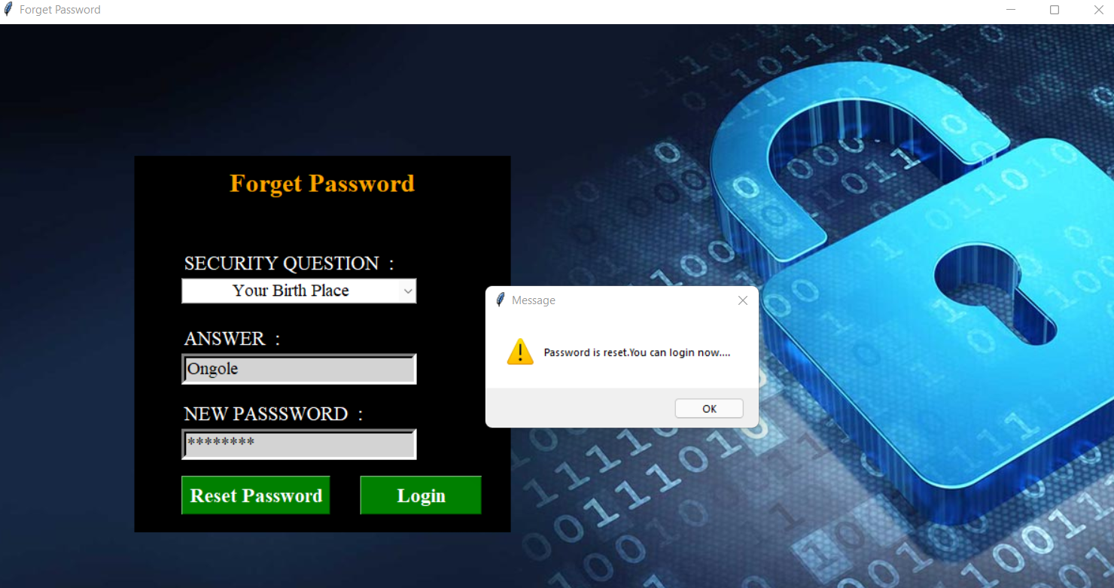

Slide 33
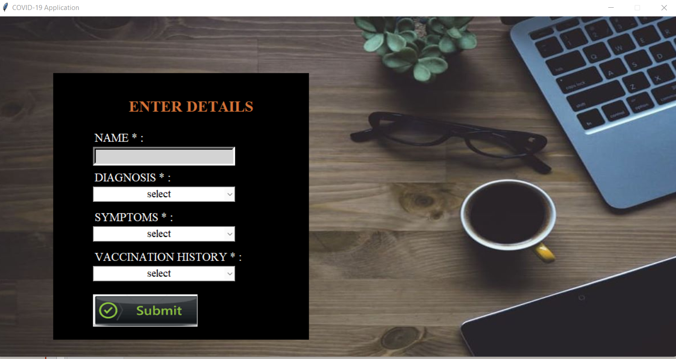
4.COVID-19 APPLICATION WINDOW

Slide 34
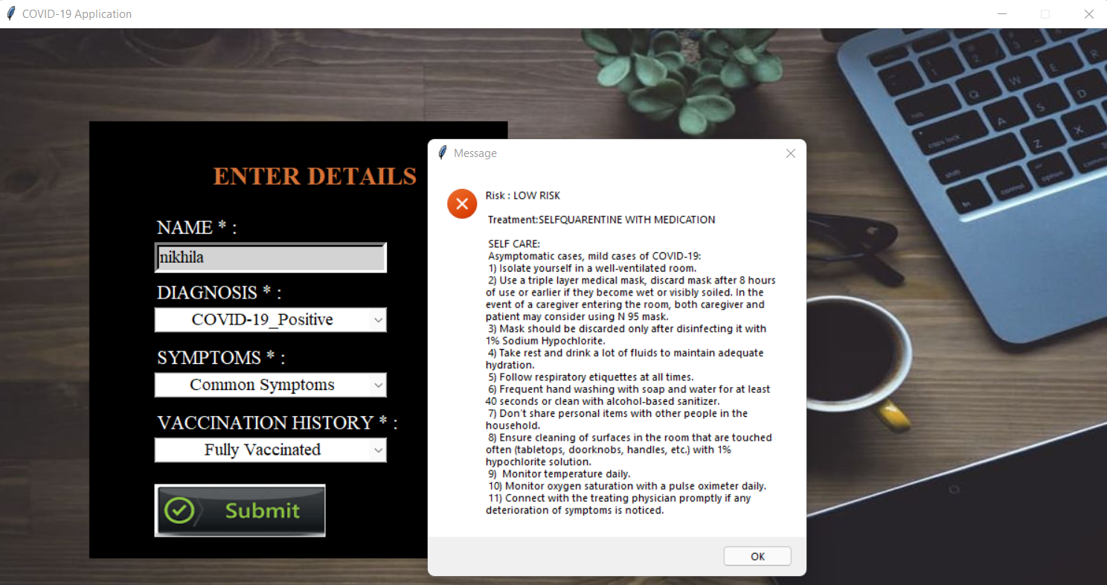

Slide 35
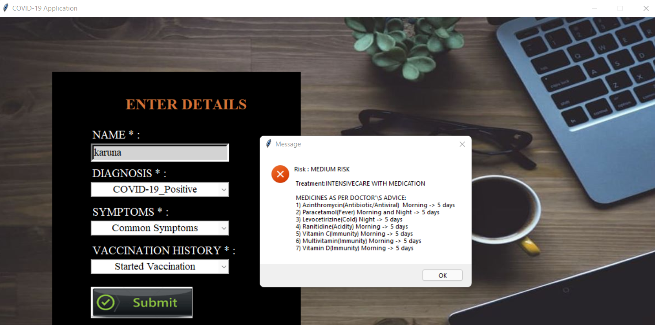

Slide 36
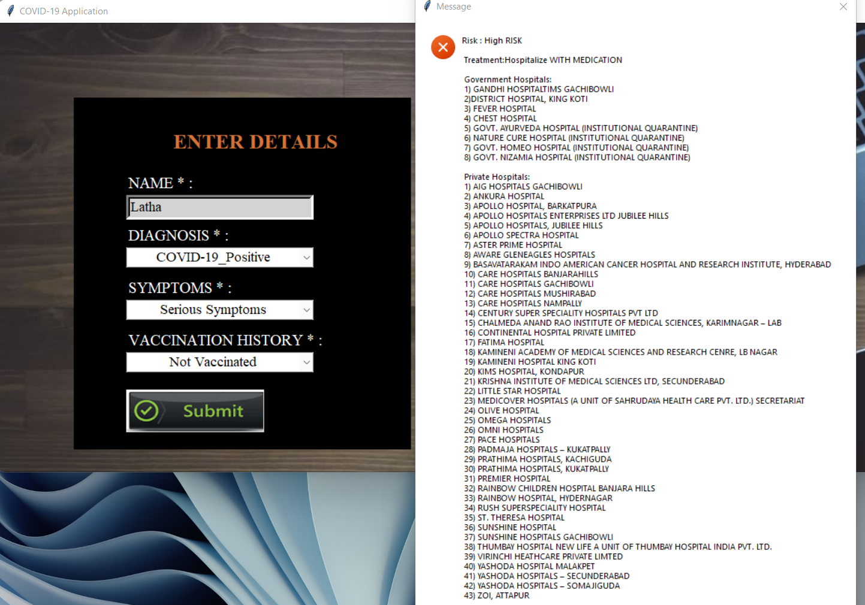

Slide 37
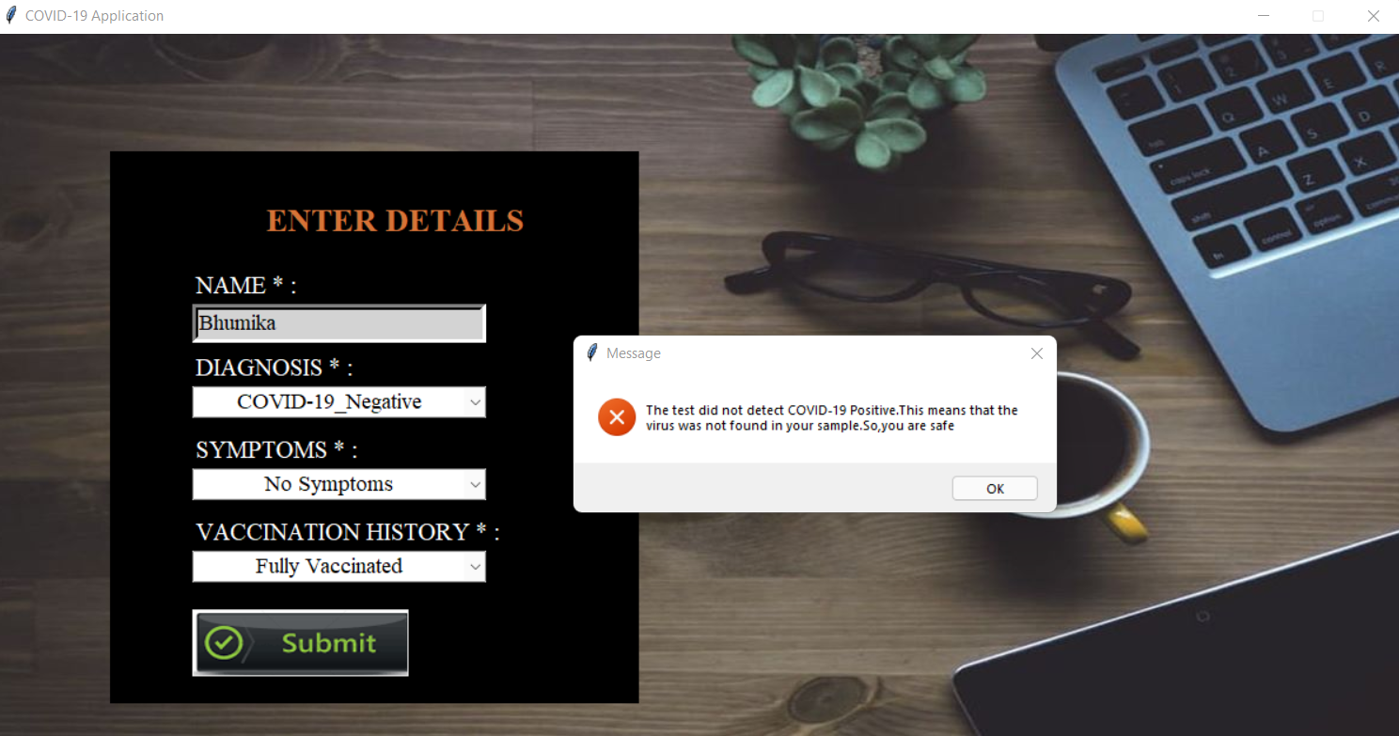

Slide 38
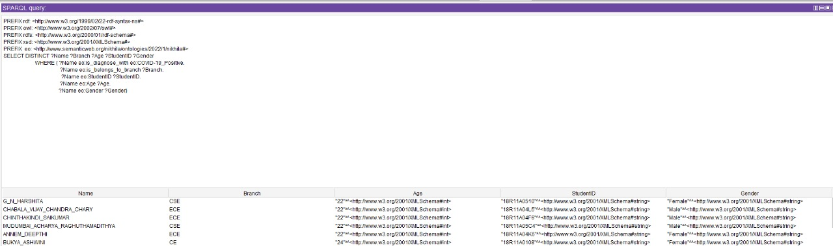
5.PROTÉGÉ TOOL QUERIES

Slide 39
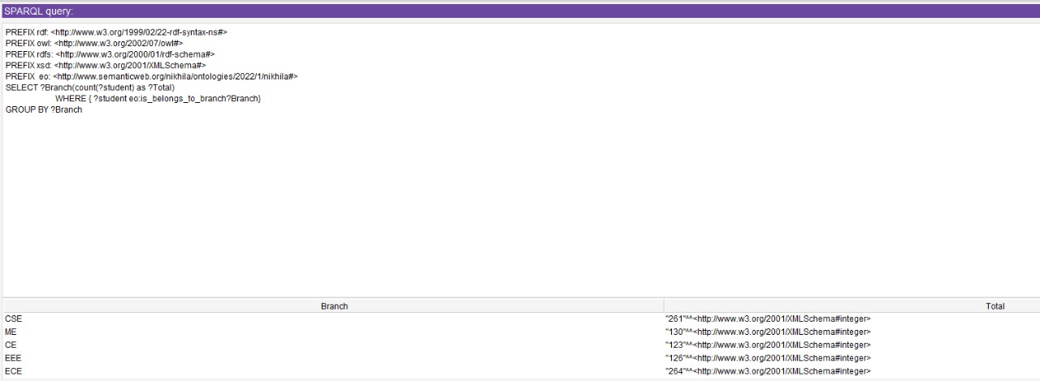

Slide 40
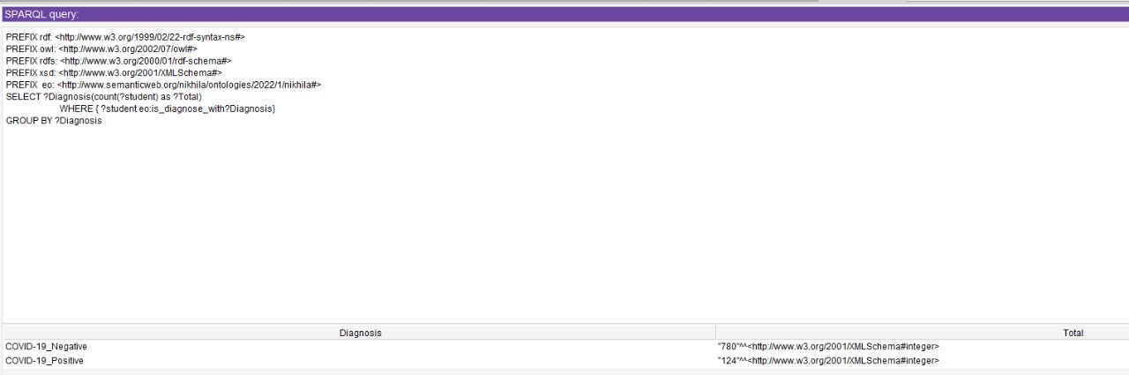

Slide 41
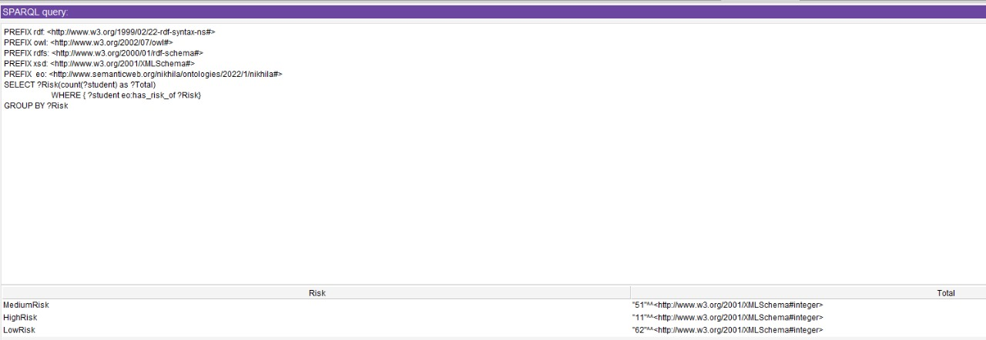

Slide 42
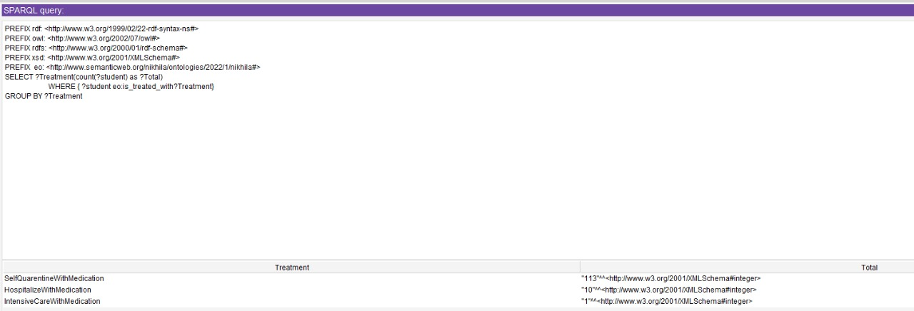

Slide 43
CONCLUSION
Through this project, the analysis on COVID-19 data has been performed successfully. We collected the student’s data and stored it in dataset. The pre-processing is done then pre-processed data will be classified with the help of opinion mining using decision making, the classified data is stored in the database on the semantic web. The data will be retrieved through SPARQL queries. This Covid-19 ontology helps in analyzing the risk factors and treatment plans for the respective individuals. The information given by the students can be automatically processed and with the help of SWRL (Semantic Web Rule Language), the risk factor and treatment plans for the students are inferred from the given knowledge followed by the output. We have limited our resource only within Hyderabad by displaying the COVID-19 treating hospitals and generating the prescription on the basis of user's symptoms. At last, the accuracy check using different metrics is performed over all the analysis done in this project.

Slide 44


